Slide 1
Smart Home Gardening
For people who wants to make home gardens but do not know how?

Slide 2
TEAM NO. 13 MEMBERS
1. Aashi Gupta
2. Garima
3. Varun Gambhir
4. Aayushi Mahor
5. Adepu Simharaju

Slide 3
PROBLEM STATEMENT:
Beginners, who are new to Home gardening, require information and details about the basic conditions for plant growth.
For example-
Types of plant growing in a particular weather condition.
Seed sowing time.
Soil type to use.
Watering frequency.
Frequency of the compost addition to the soil.

Slide 4
PROPOSED SOLUTION:
A machine which would take data of weather conditions of the area, and the temperature and humidity data of the particular place for the gardening. Then it provides the list of plants which can be grown in the region in 3 categories :-
i) decorative plants
ii) vegetable plants
iii) medicinal plants, which can be grown in houses easily.
The user can select the plant he wants to grow and then the machine provides the basic details of the plant, i.e. following:-
Seed sowing time
Soil type to be used
Watering frequency
Sunlight needed
Any other specification for maintenance of the plant

Slide 5
PROPOSED SOLUTION:
(Continued)
Further the machine will also provide the user notifications for timeline of plant growth, such as, what should be the average height of the plant grown at the time, time for the flowers to start blooming or in case of any change in the maintenance of the plant along the timeline.
Moreover the information of each individual’s home garden will be collected and stored making the machine learn for more popular plants in the regions and their growth status based on the care provided by the user.

Slide 6
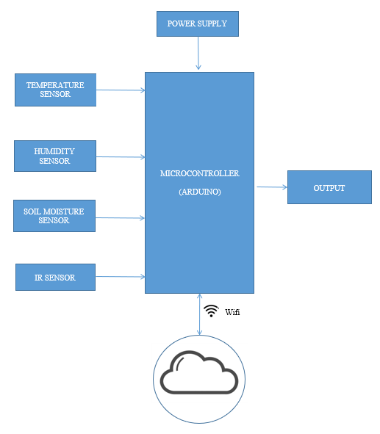
ARCHITECTURE
The proposed model consists of sensors to supervise the content of soil moisture. To achieve a proper plant growth by implementing new sensor technologies,
• Frequent updating of status of field and yield parameters, Analytics of better data collection to gather information,
• Optimizing cost and time,
• Record all the information for future reference, and
• Integration of software to improve the productivity.

Slide 7
COMPONENTS:
1. Soil Moisture Sensor
2. Temperature Sensor
3. Humidity Sensor
4. Power source (battery or wall adapter)
5. Cloud storage
6. Arduino Board
7. Wifi Module wth microcontroller/ nodemcu (inbuilt wifi module)

Slide 8
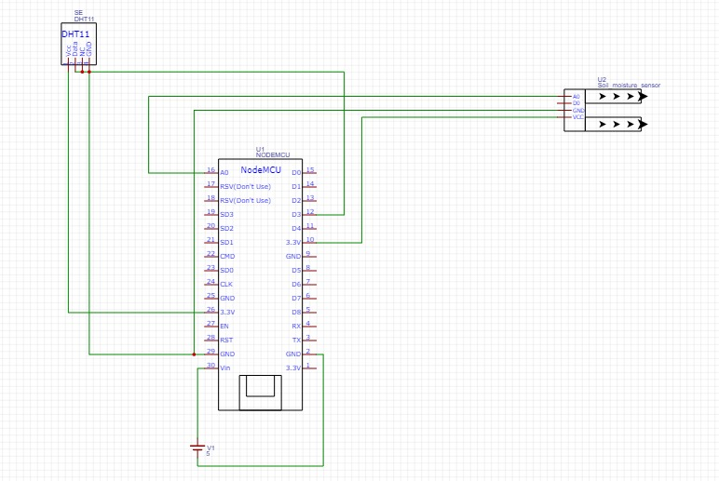
Connections

Slide 9
RESULTS
IOT based temperature , soil moistures and humidity measurement system provides an economical and safe system. This is very useful for the detection of agricultural-related parameters.
In this setup, the sensors first senses the environment and then the values are uploaded within the stipulated time period through the ESP-8266 Wi-Fi system.
Then, from the cloud, the humidity, soil moisture and temperature standards are measured using one ThingSpeak platform from anywhere.
The results of temperature , soil moistures and humidity will store on thingSpeak cloud.
This proposed system can provide a convenient method for effective monitoring of temperature , moisture of soil and humidity in real time.

Slide 10
FUTURE WORK
In the future, the extensive Arduino system can put into practice as agriculture automation system and weather-based fertilizer flower and monitor the value of the plants' growth via the mobile application.
IoT based systems are a vital step in sympathetic, relevance growth, accomplishment, and serve as a construction block for a numeral of practical modernization technique controller.
We can also include a sensor like gas, infrared, ultrasonic sensors based on their requirements. Moreover, it is possible to control the relay, actuators through internet once a sensor values are going above/below predetermined values.

Slide 11
THANK YOU

